Slide 1


INSTITUTE OF AERONAUTCAL ENGINEERING
Dundigal – Hyderabad
Civil Engineering
QUALITTY IN CONSTRUCTION MANAGEMENT
: 20951a0115
Gogula Jeevan Kumar

Slide 2

OUTLINE
Abstract
Introduction
Literature review
Methodology
Architecture
Proposed solution
Conclusion

Slide 3

ABSTRACT
Quality management plays a critical role in the construction industry, ensuring that projects meet or exceed the expectations of clients, stakeholders, and end-users. This abstract highlight the importance of quality in construction management and its impact on project performance and client satisfaction. It explores various aspects of quality management, including planning, implementation, and monitoring, and emphasizes the need for a systematic and proactive approach to ensure high-quality outcomes.
The significance of quality in construction and how it contributes to the overall success of projects. It emphasizes the role of effective quality management in mitigating risks, reducing rework, and enhancing productivity. Additionally, it recognizes the correlation between quality and client satisfaction, as meeting or surpassing expectations leads to improved reputation, repeat business, and increased stakeholder confidence.

Slide 4

The implementation phase is also addressed, emphasizing the need for rigorous quality assurance procedures, compliance with industry standards, and adherence to best practices. It highlights the role of quality control techniques, such as inspections, testing, and audits, in identifying and rectifying potential defects and non-conformities.
Highlights the positive impact of quality on project performance and client satisfaction and emphasizes the need for a comprehensive approach that encompasses planning, implementation, and monitoring. By prioritizing quality, construction organizations can deliver successful projects, build strong client relationships, and foster a culture of excellence in the industry.

Slide 5
INTRODUCTION
Quality management is a fundamental aspect of the construction industry, encompassing a range of practices and processes aimed at ensuring that projects are executed to meet or exceed predetermined standards and client expectations. The pursuit of quality is vital in construction management as it directly influences project performance, client satisfaction, and overall industry reputation.
The construction industry is complex and involves multiple stakeholders, including clients, architects, engineers, contractors, and subcontractors, each with their unique expectations and requirements. To deliver successful projects, it is essential to implement effective quality management strategies that promote consistency, efficiency, and adherence to industry standards.
In recent years, the construction industry has witnessed a shift towards a more proactive approach to quality management. Traditionally, quality was often viewed as a reactive process, with defects being addressed after they were identified.

Slide 6
Moreover, the importance of quality extends beyond the immediate project scope. High-quality construction projects contribute to the overall built environment, enhancing the safety, functionality, and aesthetics of communities. By prioritizing quality management, the construction industry can foster sustainable development, address environmental concerns, and create lasting value for society.
Quality management is a critical aspect of construction management, with far-reaching implications for project performance, client satisfaction, and industry reputation. By embracing a proactive and systematic approach to quality, construction professionals can ensure successful project outcomes, foster client relationships, and contribute to the growth and advancement of the construction industry.

Slide 7
LITERATURE REVIEW
Quality Management in Construction Projects: " by Abdul-Rashid Abdul-Aziz, Abdul-Rashid Abdul-Aziz, et al. (2012) This comprehensive review provides an overview of quality management practices in construction projects. It covers topics such as quality planning, control, assurance, and improvement, highlighting the importance of integrating quality management into all project phases.
"Total Quality Management in Construction Projects:" by Ibrahim Mahamid (2016) The paper explores the application of Total Quality Management (TQM) principles in construction projects. It discusses the benefits of TQM, including improved communication, increased customer satisfaction, and enhanced project performance. It also presents case studies illustrating successful TQM implementation.

Slide 8
"Quality Control in Construction: " by Chunping Ou, Jinping Ou, and Qingping Zou (2014) This literature review focuses on quality control practices in construction. It examines the use of quality control tools and techniques, such as statistical process control, quality inspections, and quality audits. The paper emphasizes the need for proactive quality control measures to prevent defects and ensure compliance with quality standards.
“Quality Management Practices in Construction Projects: An Exploratory Study" "by Rafał Mróz and Michał Mróz (2020) The study investigates quality management practices in construction projects, drawing insights from interviews with industry professionals. It explores the challenges faced in implementing quality management systems and highlights the importance of leadership commitment, training, and continuous improvement in achieving quality objectives.
Notes:
https://www.youtube.com/watch?v=FLm3pxBtTaU
https://www.youtube.com/watch?v=CcaRfwlHyNw

Slide 9
"Quality Performance Measurement in Construction Projects: " by Ke Lu, Jiaming Wang, and Jiuping Xu (2018) This review focuses on quality performance measurement in construction projects. It discusses different quality performance indicators, metrics, and frameworks used to assess and improve quality. The paper emphasizes the need for a comprehensive and balanced approach to measuring quality performance.
"Integration of Lean Construction and Six Sigma: " by Charbel José Chiappetta Jabbour, Carlos Alberto Chaves, et al. (2013) The literature review explores the integration of Lean Construction and Six Sigma methodologies for quality improvement in construction. It discusses the synergies between the two approaches and their potential to enhance productivity, eliminate waste, and reduce defects in construction projects.
Notes:
https://www.youtube.com/watch?v=FLm3pxBtTaU
https://www.youtube.com/watch?v=CcaRfwlHyNw

Slide 10
"Implementation of Building Information Modeling (BIM) for Quality Management in Construction Projects: " by Nima Moayedian and Martin Skitmore (2016) The paper reviews the implementation of Building Information Modeling (BIM) for quality management in construction projects. It examines the benefits of BIM in improving collaboration, visualization, and clash detection, leading to enhanced quality control and project outcomes.
"Quality Management in Construction Projects: A Strategic Perspective" by Kiyoo Nakamura and Hideaki Yasuhara (2015) This paper provides a strategic perspective on quality management in construction projects. It emphasizes the need for aligning quality objectives with overall project objectives and integrating quality management into project planning and decision-making processes. The paper also discusses the role of leadership, organizational culture, and continuous improvement in achieving strategic quality goals.
Notes:
https://www.youtube.com/watch?v=FLm3pxBtTaU
https://www.youtube.com/watch?v=CcaRfwlHyNw

Slide 11
"Implementation of Lean Construction Principles in Quality Management: " nár, Árpád Harmati, et al. (2019) This systematic literature review examines the implementation of Lean Construction principles in quality management. It explores how Lean Construction tools and techniques can improve quality outcomes, reduce waste, and enhance efficiency in construction projects.
"Digital Quality Management in Construction: A Review of State-of-the-Art Technologies and Practices" by Mehmet Gokhan Asan and Yuzhong Liu (2021) This review focuses on digital quality management in construction, exploring state-of-the-art technologies and practices. It discusses the use of Building Information Modeling (BIM), Internet of Things (IoT), data analytics, and other digital tools to enhance quality control, documentation, and decision-making in construction projects.

Slide 12
"Critical Success Factors for Implementing Quality Management Systems in Construction: " by Ivan Paz, Héctor Martínez, et al. (2020) This systematic literature review identifies the critical success factors for implementing quality management systems (QMS) in the construction industry. It explores factors such as leadership commitment, employee involvement, training, and communication, providing insights into effective strategies for successful QMS implementation.
"The Role of Quality Culture in Construction: " by Hiba Hadigheh, Abdulhadi M. Alkaabi, et al. (2021) This review focuses on the role of quality culture in construction projects. It examines the factors influencing quality culture development, including leadership, organizational values, and employee engagement. The paper highlights the significance of creating a culture that fosters a commitment to quality at all levels of the organization.

Slide 13
METHODOLOGY
Quality management in construction encompasses a systematic approach to ensuring that construction projects meet or exceed predetermined standards and client expectations.
Quality Planning:
Define quality objectives: Establish clear and measurable quality objectives for the project, considering the project scope, client requirements, and applicable regulations.
Identify quality requirements: Determine specific quality requirements, including materials, workmanship, performance criteria, and industry standards.
Develop quality control procedures: Define procedures and guidelines for quality control activities such as inspections, testing, and documentation.
Engage stakeholders: Involve all relevant stakeholders, including clients, designers, contractors, and suppliers, in the quality planning process to ensure a shared understanding of quality expectations.

Slide 14
Quality Assurance:
Establish quality assurance processes: Implement processes and procedures to ensure that quality requirements are met throughout the project lifecycle.
Conduct quality audits: Regularly assess and evaluate project activities to verify compliance with quality standards, identify non-conformities, and initiate corrective actions.
Monitor subcontractors and suppliers: Ensure that subcontractors and suppliers adhere to quality requirements through regular monitoring and evaluation.
Document control: Establish a system for maintaining and controlling project documentation, including quality records, test reports, and certifications.

Slide 15
Quality Control:
Inspections and testing: Conduct inspections and testing activities to verify the quality of materials, workmanship, and construction processes.
Non-conformance management: Identify and address non-conformities promptly, taking corrective actions to rectify issues and prevent recurrence.
Continuous improvement: Foster a culture of continuous improvement by encouraging feedback, analyzing performance data, and implementing corrective and preventive actions.

Slide 16
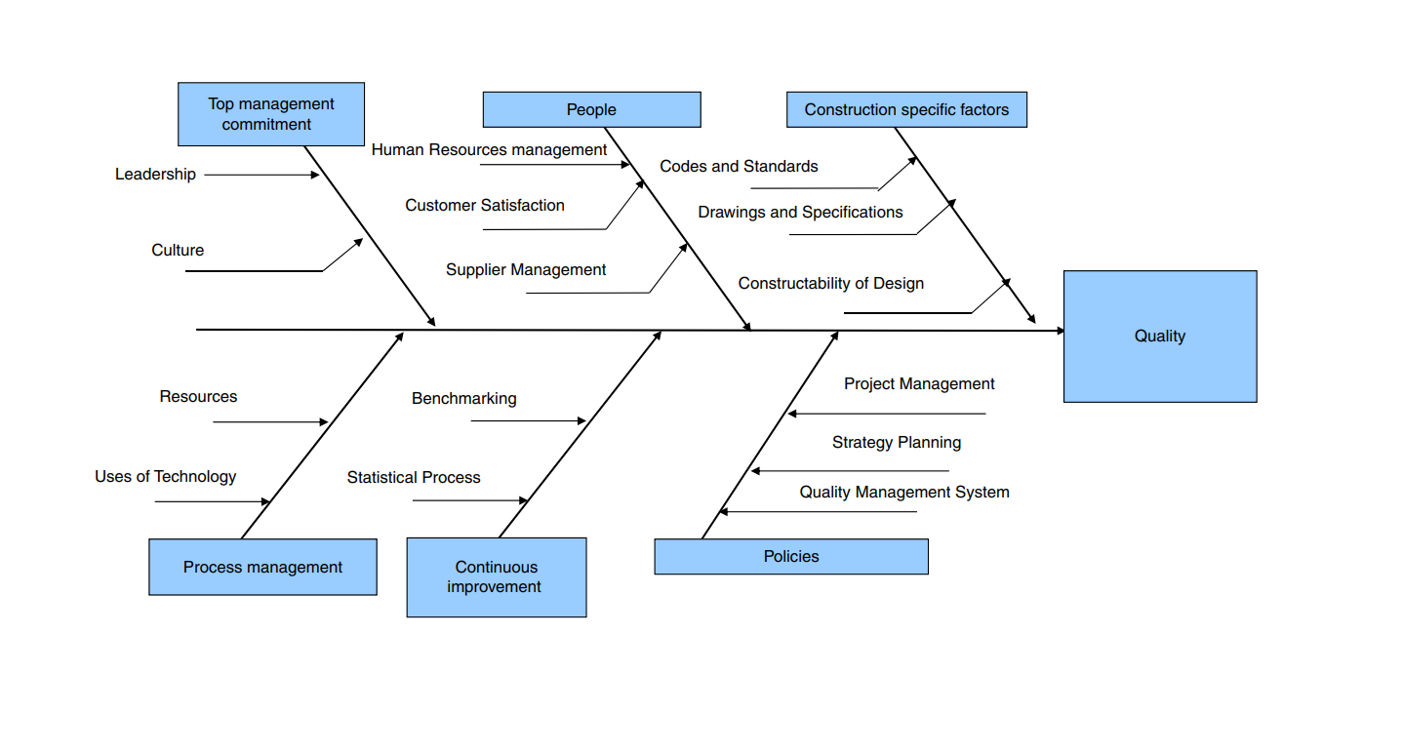
ARCHITECTURE
QUALITY PAPER Quality in construction managementQUALITY PAPER Quality in construction managementQUALITY PAPER Quality in construction management

Slide 17
PROPOSED SOLUTION
Establish a Quality Management System (QMS):
Develop a structured QMS that outlines quality policies, procedures, and standards for the entire construction process.
Clearly define quality objectives, performance indicators, and measurement techniques.
Implement a documentation control system to manage quality-related documents and ensure version control and accessibility.
Foster a Quality Culture:
Promote a culture of quality among all project stakeholders, emphasizing the importance of quality in every aspect of the construction process.
Provide training and awareness programs to educate personnel about quality management principles, practices, and their roles in achieving quality objectives.
Encourage active participation and engagement in quality improvement initiatives.

Slide 18
Implement Quality Planning:
Conduct a thorough analysis of project requirements and define clear quality specifications and standards.
Develop a comprehensive quality plan that outlines quality control activities, inspection points, and quality assurance procedures.
Integrate quality planning with other project management processes to ensure alignment and effective coordination.
Engage in Proactive Quality Control:
Perform regular inspections and testing at various stages of the construction process to identify and address quality issues early.
Implement quality control techniques such as statistical process control, quality checklists, and quality audits to monitor and control quality.

Slide 19
Ensure Supplier and Contractor Quality:
Establish stringent supplier and contractor qualification processes to ensure they meet quality requirements.
Conduct thorough supplier and contractor evaluations and audits to monitor and assess their performance.
Implement effective communication channels to convey quality expectations and requirements to suppliers and contractors.
Continuous Improvement:
Establish a feedback loop for capturing lessons learned and identifying areas for improvement.
Conduct root cause analysis for non-conformities and implement corrective and preventive actions.
Regularly review and update quality management processes and procedures based on lessons learned and industry best practices.

Slide 20
CONCLUSION
In conclusion, quality construction management plays a vital role in ensuring successful and sustainable construction projects. It involves the coordination of various activities and resources to deliver high-quality results that meet or exceed stakeholders' expectations. Here are the key points to consider regarding the importance and benefits of quality construction management.
Quality construction management is crucial for achieving project success, ensuring cost savings, enhancing safety, satisfying stakeholders, building reputation, and promoting sustainability. By prioritizing quality throughout the construction process, from planning to completion, construction managers can deliver exceptional results that meet the needs of all parties involved and set the foundation for continued success in the industry.

Slide 21
Thank You

